Slide 1
TF-IDF Document Ranking
Khadim Hussain 2021-cs-204

Slide 2


Objective
Rank documents with respect to provided query using TF-IDF calculation

Slide 3
Document Gathering
14 text files
2-3 sentences per file

Slide 4

What is Document Ranking?
Imagine a library where you want to find the most relevant books or documents for a topic. A document ranking system helps you by showing the most relevant documents first!

Slide 5
Introduction to TF-IDF
TF-IDF stands for Term Frequency-Inverse Document Frequency.
It is a numerical statistic that reflects the importance of a word in a document relative to a collection of documents.

Slide 6

Real-life Example
Imagine you have a collection of news articles. TF-IDF helps you find the most relevant articles based on a search query by considering both the frequency of terms in the articles and their rarity across all articles.

Slide 7

Term Frequency (TF)
TF measures how frequently a term appears in a document.
It is calculated as the number of times a term appears in a document divided by the total number of terms in the document.

Slide 8
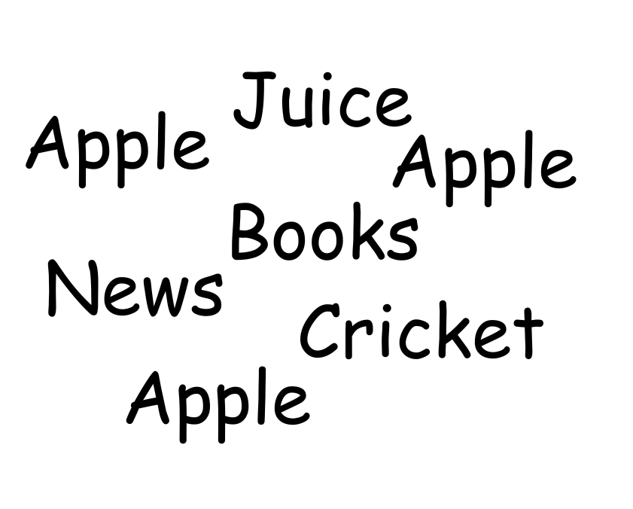
Term Frequency (TF)
In this document
Total words: 7
Occurrences of ‘Apple’ : 3
TF for ‘Apple’ = 3/7 = 0.42

Slide 9
Inverse Document Frequency (IDF)
IDF measures how important a term is.
It is calculated as the logarithm of the total number of documents divided by the number of documents containing the term.

Slide 10
Inverse Document Frequency (IDF)
For example, We have 10 documents
The term ‘apple’ appears in 3 documents.
IDF of apple will be log(10/3) = 0.52
It measures uniqueness of term
If a term, say ‘man’ appears in 7 out of 10 documents, its IDF will be log(10/7) = 0.15 (Less valuable)

Slide 11

TF-IDF Calculation
TF-IDF is calculated as the product of TF and IDF.
It helps to identify terms that are important to a document but not common across all documents.

Slide 12
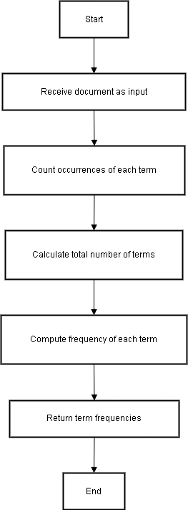
Code Example - TF Calculation
Python code snippet to calculate Term Frequency (TF):
def compute_tf(document):
tf = Counter(document)
total_terms = len(document)
for term in tf:
tf[term] = tf[term] / total_terms
return tf

Slide 13
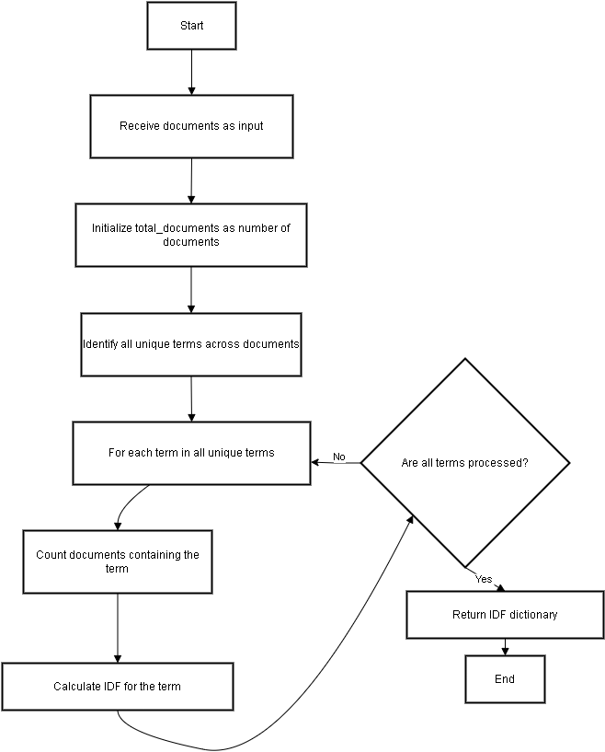
Code Example - IDF Calculation
Python code snippet to calculate Inverse Document Frequency (IDF):
def compute_idf(documents):
idf = {}
total_documents = len(documents)
all_terms = set(term for doc in documents for term in doc)
for term in all_terms:
containing_docs = sum(1 for doc in documents if term in doc)
idf[term] = math.log(total_documents / (1 + containing_docs))
return idf

Slide 14
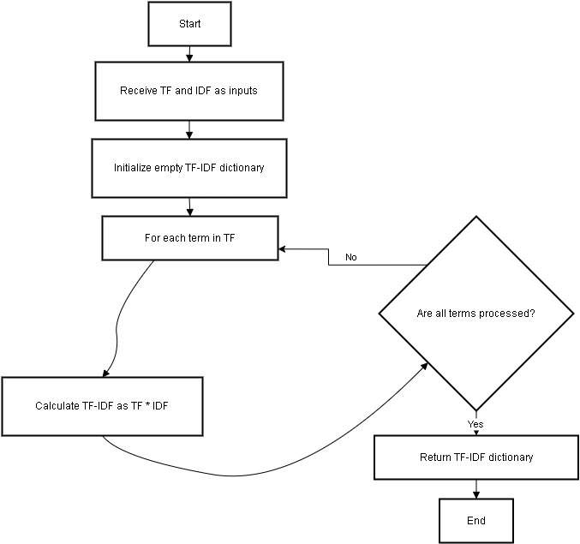
Code Example - TF-IDF Calculation
Python code snippet to calculate TF-IDF:
def compute_tfidf(tf, idf):
tfidf = {}
for term, tf_value in tf.items():
tfidf[term] = tf_value * idf.get(term, 0)
return tfidf

Slide 15
Code Example - Document Ranking
Input: Query and documents.
Preprocess the query (if required) or split it into terms.
Extract and split the content of each document into words.
Compute TF for each document and the query.
Compute IDF using the document corpus.
Compute TF-IDF for each document and the query.
Calculate similarity scores between query TF-IDF and each document's TF-IDF.
Filter documents with scores > 0.
Highlight matching terms in the content of those documents.
Rank the documents by score in descending order.
Output the ranked documents.

Slide 16

Conclusion
TF-IDF is a powerful technique for ranking documents based on their relevance to a query. By understanding and implementing TF-IDF, you can improve the search functionality of your applications.

